Slide 1
K-Means Clustering

Slide 2
Learning Goals
In this section, we will cover:
- K-Means Algorithm
- K-Means Initialization
- Number of Clusters in K-Means
- K-Means Clustering syntax

Slide 3
K-Means Algorithm
K-Means Clustering is an unsupervised learning algorithm that is used to solve the clustering problems in machine learning or data science.
A cluster refers to a collection of data points aggregated together because of certain similarities.
The K-means algorithm identifies k number of centroids, and then allocates every data point to the nearest cluster, while keeping the centroids as small as possible.
The ‘means’ in the K-means refers to averaging of the data; that is, finding the centroid.

Slide 4
K-Means Algorithm
Step 1 - Randomly assign cluster centroids.
Step 2 - Assign each point to the cluster that is closer than other cluster (centroid)..
Step 3 - Move each centroid to cluster’s mean.
Step 4 - if points don’t change (converged) then stop else go to step 2

Slide 5
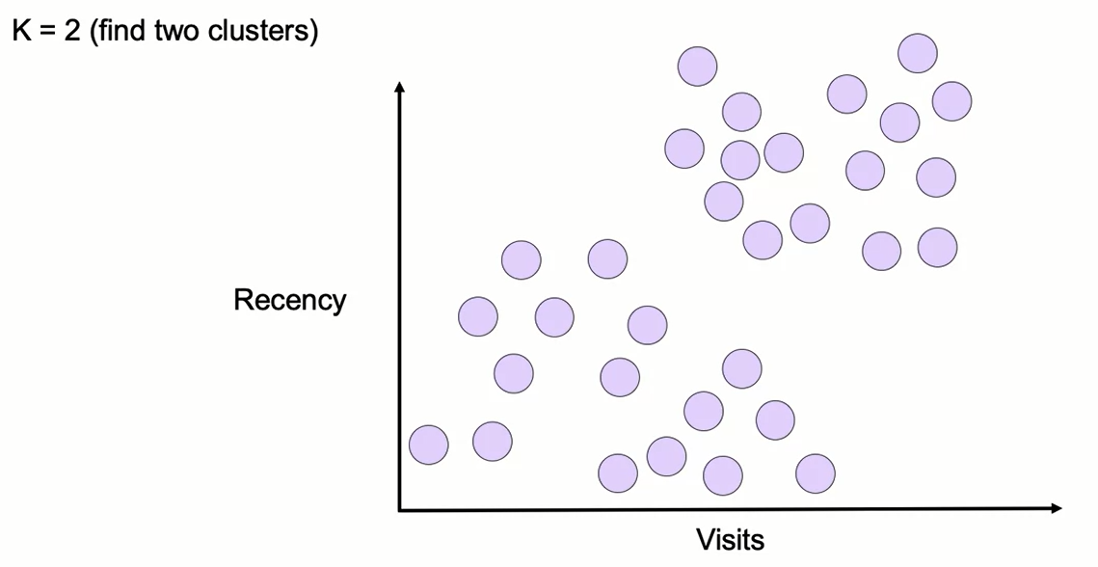
K-Means Algorithm

Slide 6
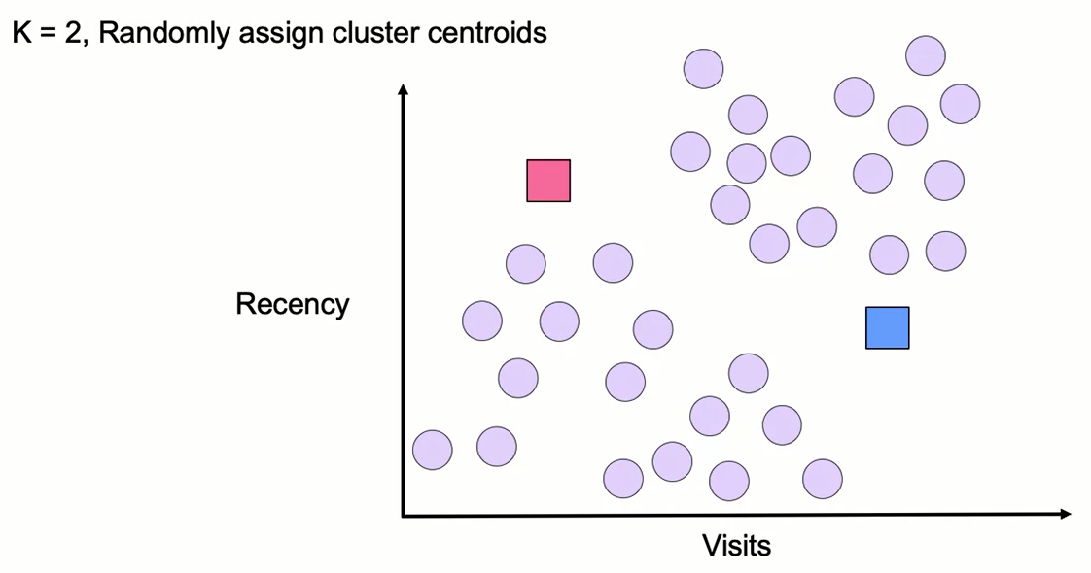
K-Means Algorithm

Slide 7
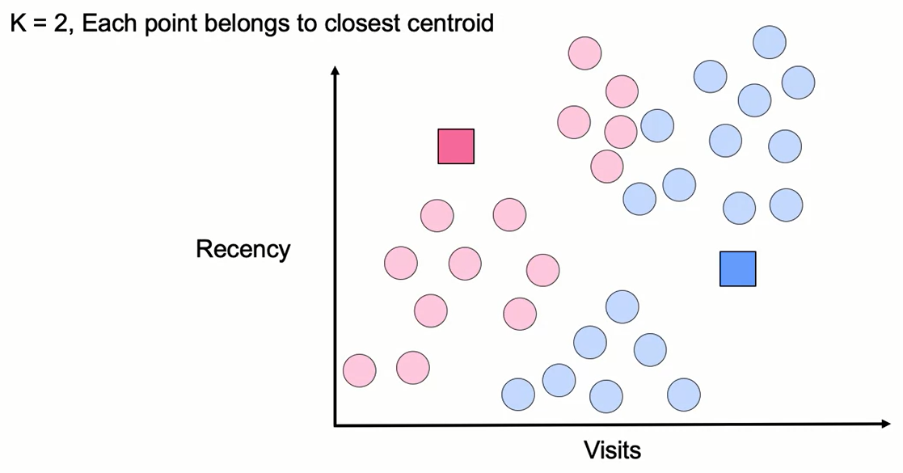
K-Means Algorithm

Slide 8
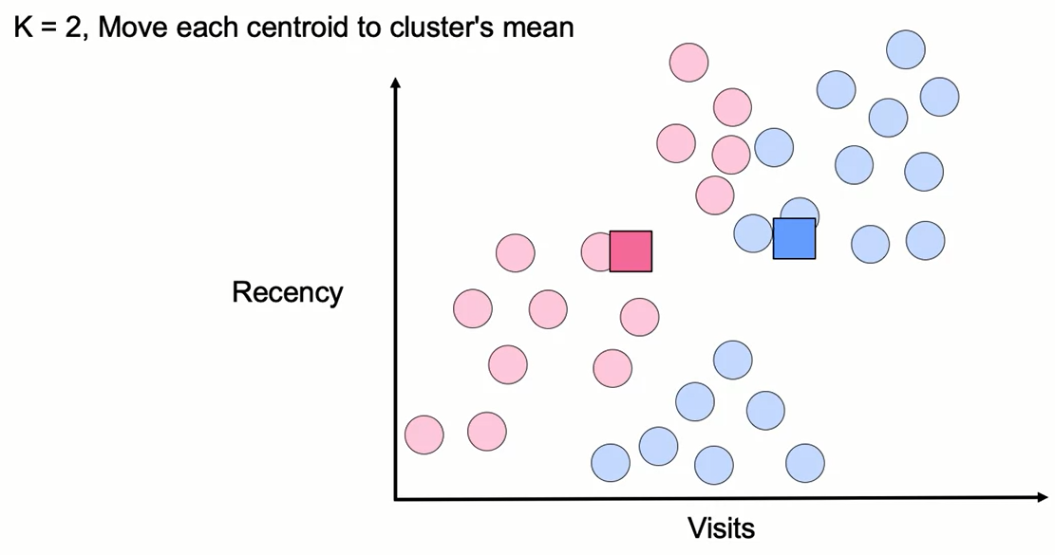
K-Means Algorithm

Slide 9
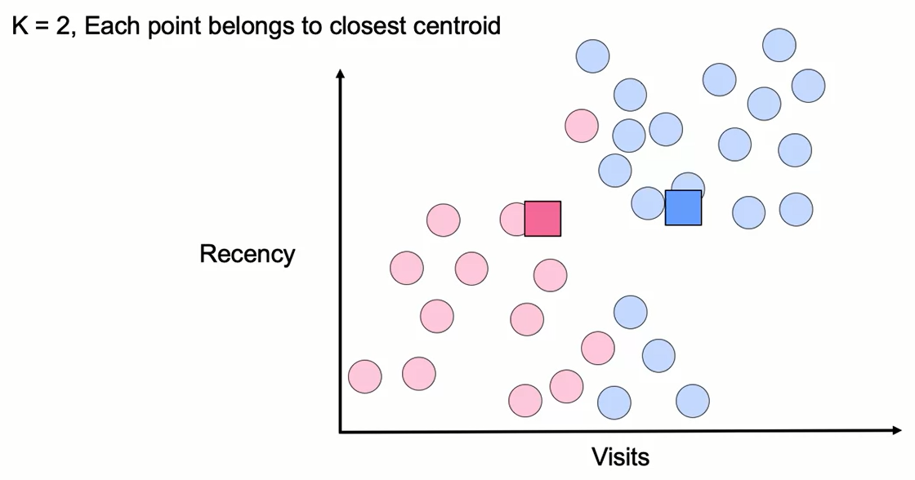
K-Means Algorithm

Slide 10
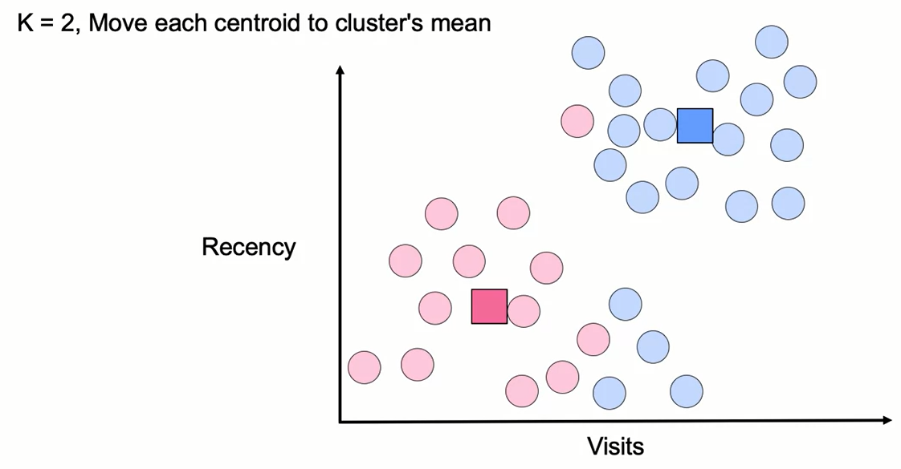
K-Means Algorithm

Slide 11
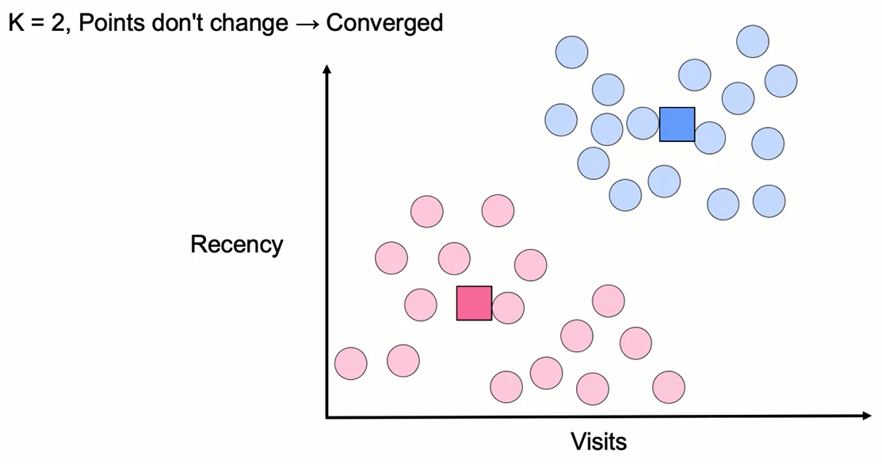
K-Means Algorithm

Slide 12
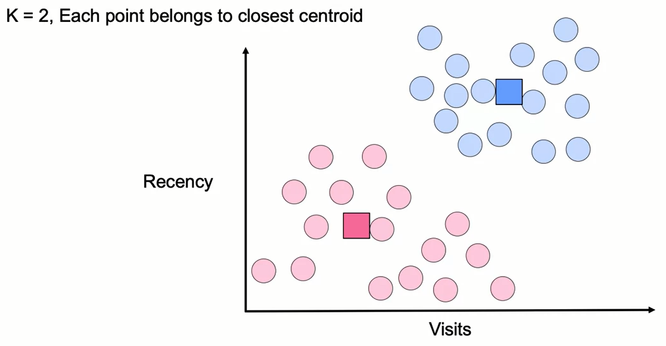
K-Means Algorithm

Slide 13
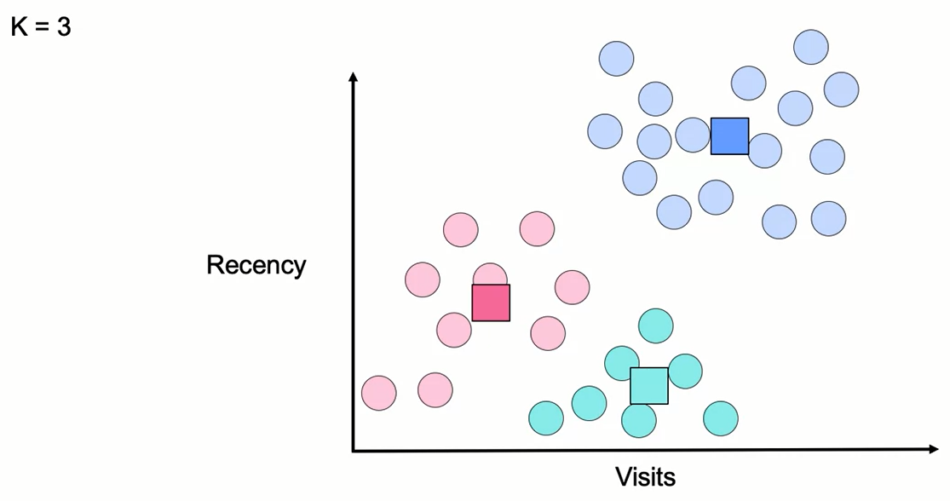
K-Means Algorithm

Slide 14
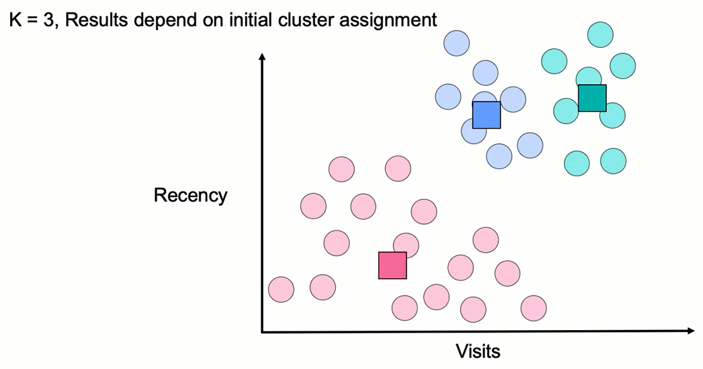
K-Means Algorithm

Slide 15
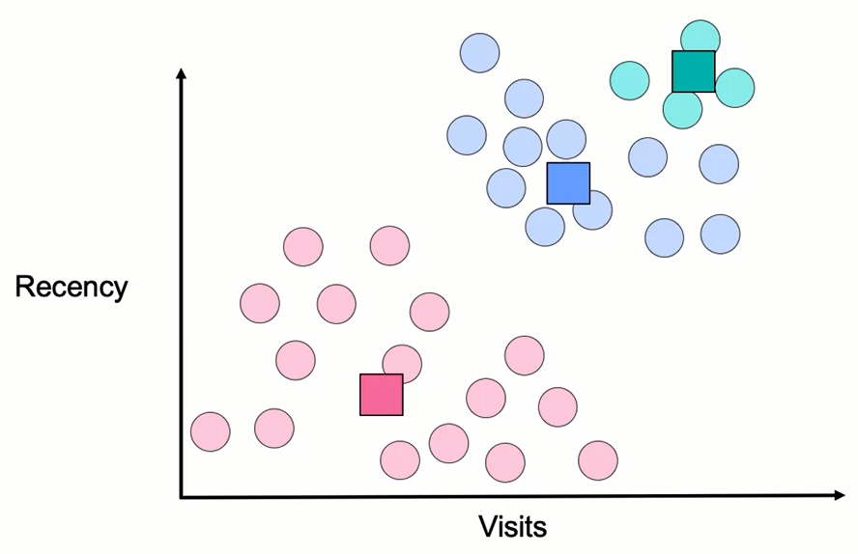
Which Model is the Right One?

Slide 16
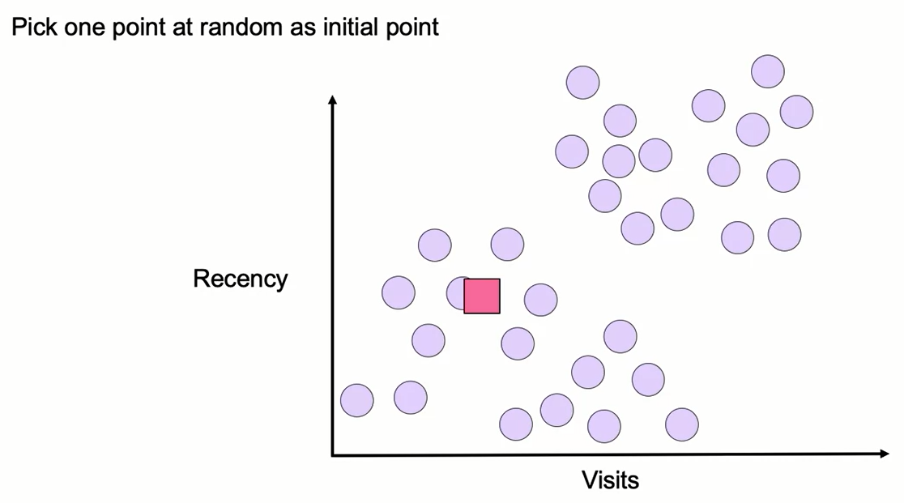
Smarter Initialization of K-Means Clusters

Slide 17
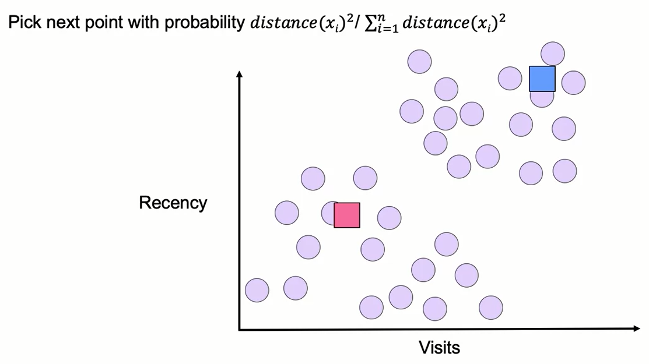
Smarter Initialization of K-Means Clusters

Slide 18
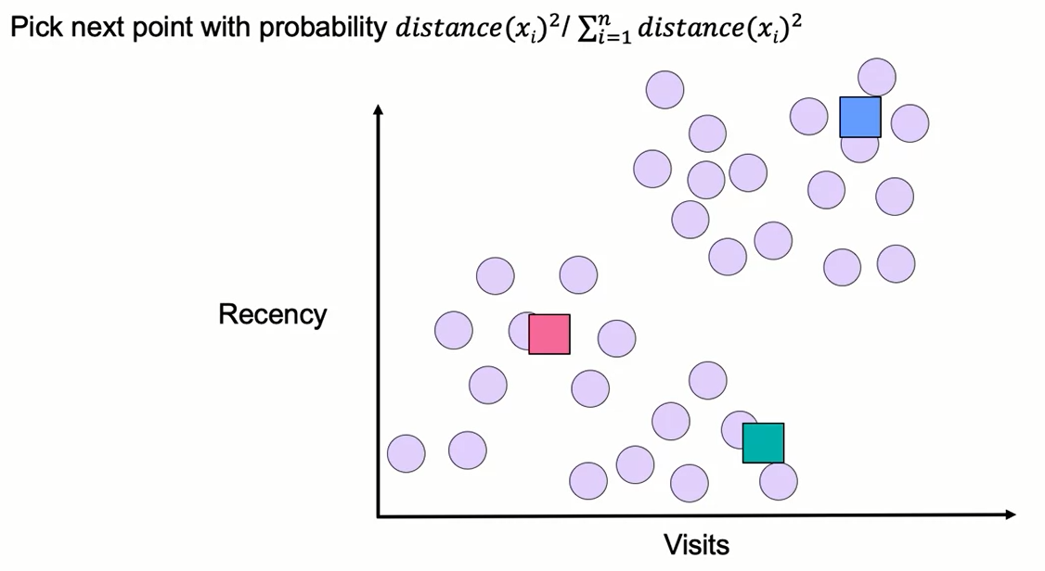
Smarter Initialization of K-Means Clusters

Slide 19
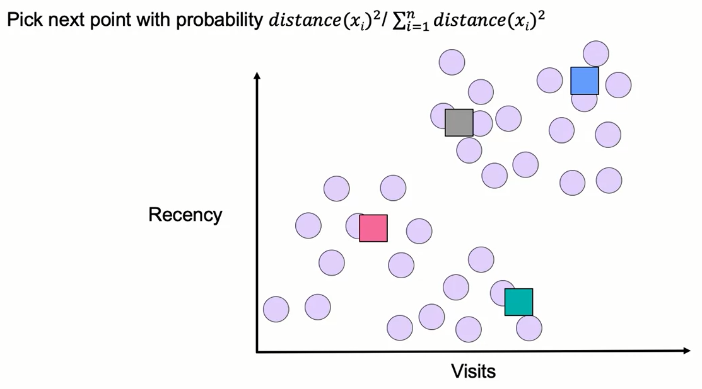
Smarter Initialization of K-Means Clusters

Slide 20
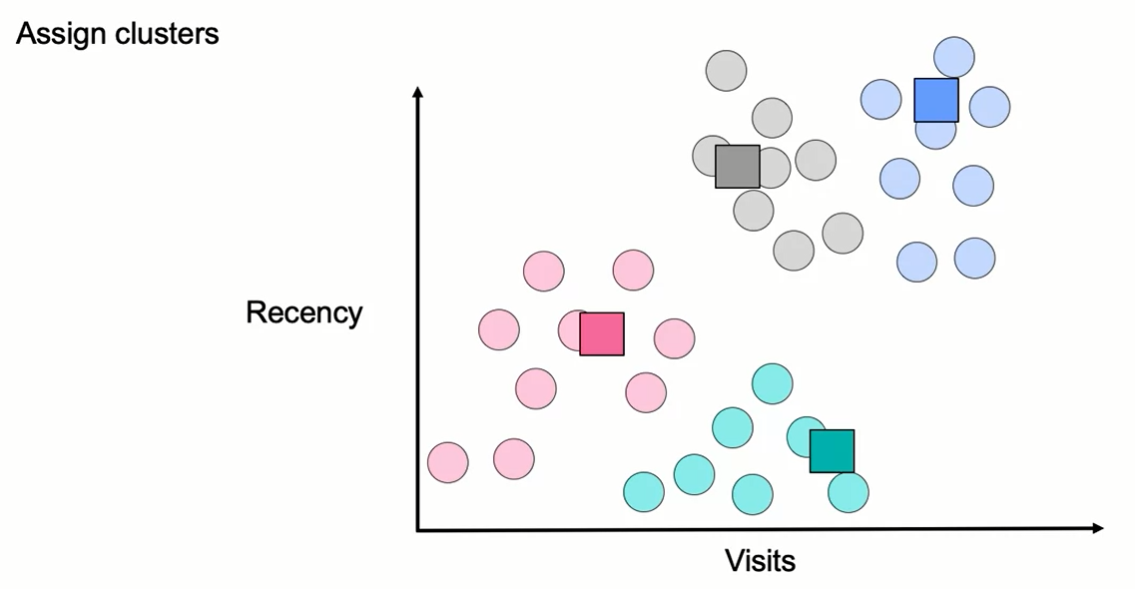
Smarter Initialization of K-Means Clusters

Slide 21
Choosing the Right Number of Clusters
Sometimes the question has a K:
- Clustering similar jobs on 4 CPU cores (K=4)
- A clothing design in 10 different sizes to cover most people (K=10)
- A navigation interface for browsing scientific papers with 20 disciplines (K=20)
Often, the number of clusters (K) is unclear, and we need an approach to select it.

Slide 22
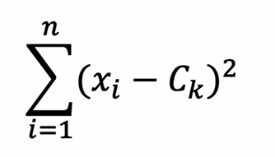
Evaluating Clustering Performance
- Inertia: sum of squared distance from each point (x_{i}) to its cluster (C_{K}).
- Smaller value corresponds to tighter clusters.
- Value sensitive to number of points in cluster.

Slide 23
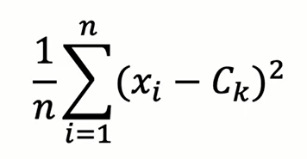
Evaluating Clustering Performance
- Distortion: average of squared distance from each point (x_{i}) to its cluster (C_{K}).
- Smaller value corresponds to tighter clusters.
- Doesn't generally increase as more points are added (relative to Inertia)

Slide 24
Which Model is the Right One?
Initiate multiple times, and take the model with the best score.

Slide 25
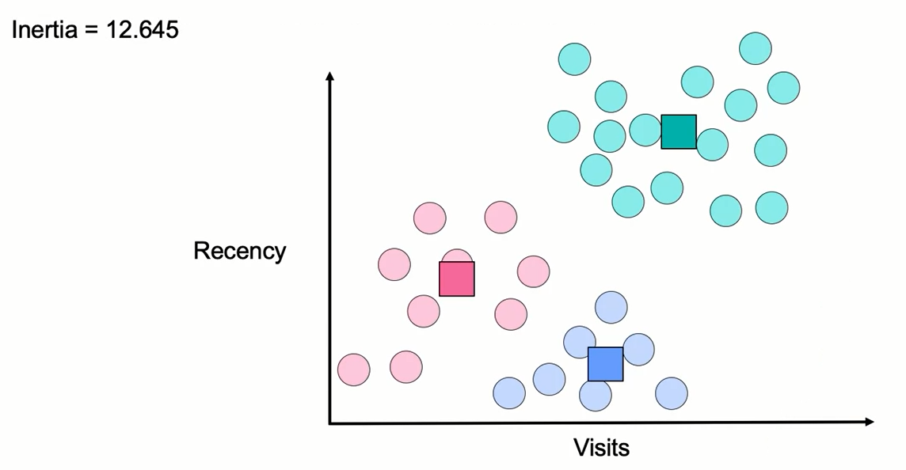
Which Model is the Right One?

Slide 26
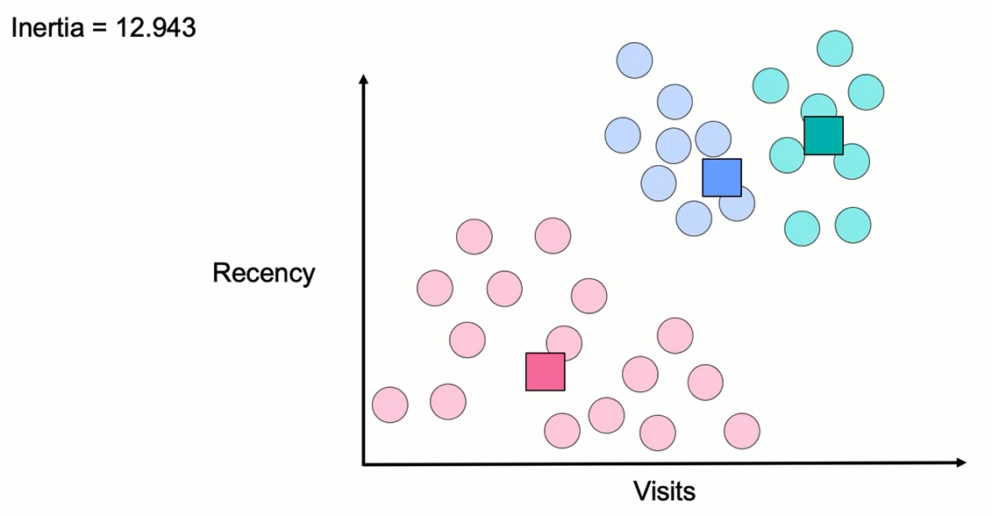
Which Model is the Right One?

Slide 27
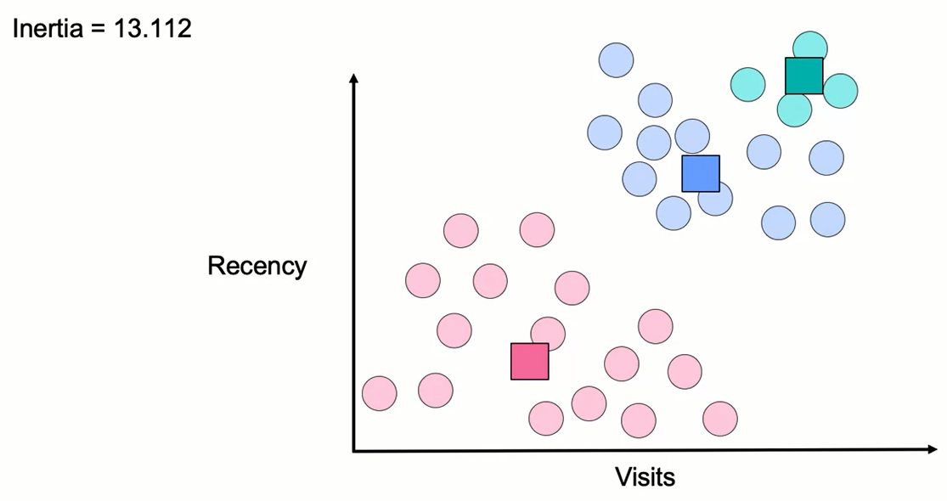
Which Model is the Right One?

Slide 28
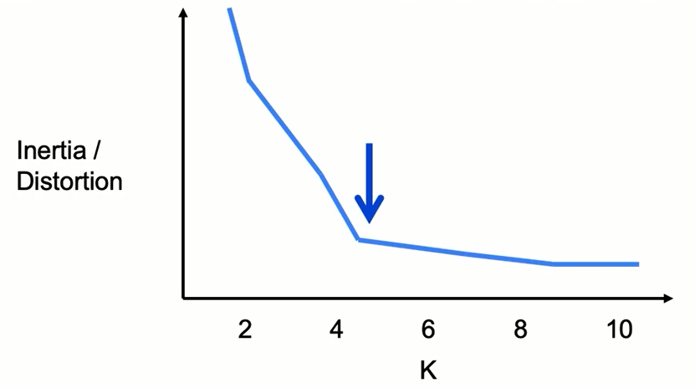
Choosing the Right Number of Clusters
Inertia measures distance of point to cluster.
Value decreases with increasing K as long as cluster density increases.

Slide 29
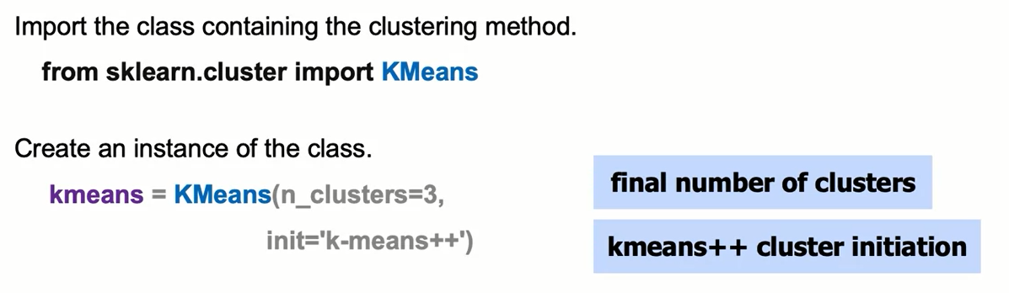
K-Means: The Syntax

Slide 30
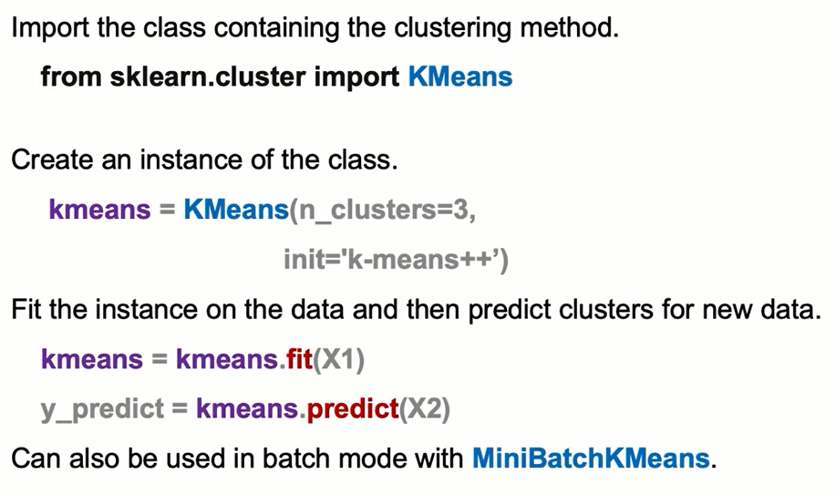
K-Means: The Syntax

Slide 31
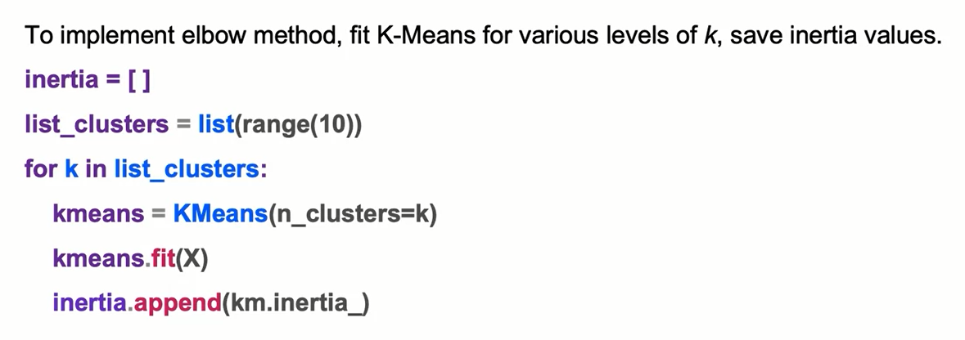
K-Means: Elbow Method Syntax

Slide 32
Summary
K-means Clustering
K-means clustering is an iterative process in which similar observations are grouped together. To do that, this algorithm starts by taking 2 random points known as centroids, and starts calculating the distance of each observation to the centroid, and assigning each cluster to the nearest centroid. After the first iteration, every point belongs to a cluster.
Next, the number of centroids increases by one, and the centroid for each cluster is recalculated as the points with the average distance to all points in a given cluster. Then, we keep repeating this process until no example is assigned to another cluster.

Slide 33
Summary
K-means Clustering
And this process is repeated k-times, hence the name k-means. This algorithm converges when clusters do not move anymore.
We can also create multiple clusters, and we can have multiple solutions. By multiple solutions, we mean that the clusters are not going to move anymore (they converged), but we can converge in different places, where we no longer move those centroids.

Slide 34
Summary
Advantages and Disadvantages of K-Means
The main advantage of k-means algorithm is that it is easy to compute. One disadvantage is that this algorithm is sensitive to the choice of the initial points, so different initial configurations may yield different results.
To overcome this, there is a smarter initialization of K-mean clusters called K-means ++, which helps to avoid getting stuck at local optima. This is the default implementation of the K-means.

Slide 35
Summary
Model Selection, choosing K number of clusters
Sometimes you want to split your data into a predetermined number of groups or segments. Often, the number of clusters (K) is unclear, and you need an approach to select it.
A common metric is Inertia, defined as the sum of squares distance from each point to its cluster centroid.
Smaller values of Inertia correspond to tighter clusters, this means that we are penalizing spread out clusters and rewarding clusters that are tighter to their centroids.
The drawback of this metric is that its value sensitive to number of points in clusters. The more points you add, the more you will continue penalizing the inertia of a cluster, even if those points that are relatively closer to the centroids than the existing points.

Slide 36
Summary
Model Selection, choosing K number of clusters
Another metric is Distortion, defined as the average of squared distance from each point to its cluster.
Smaller values of distortion corresponds to tighter clusters.
An advantage of distortion is that it doesn’t generally increase, as more points are added (relative to inertia). This means that it doesn’t increase distortion, as closer points will actually decrease the average distance to the cluster centroid.

Slide 37
Summary
Inertia Vs. Distortion
Both Inertia and Distortion are measures of entropy per cluster.
Inertia will always increase, as more members are added to each cluster, while this will not be the case with distortion.
When the similarity of the points in the cluster are very relevant, you should use distortion and if you are more concerned that clusters should have a similar number of points, then you should use inertia.
Finding the right cluster
To find the cluster with a low entropy metric, you can run a few k-means clustering models with different initial configurations, compare the results, and determine which one of the different initializations of configurations leads to the lowest inertia or distortion.

Slide 38
Learning Recap
In this section, we covered:
- K-Means Algorithm
- K-Means Initialization
- Number of Clusters in K-Means
- K-Means Clustering syntax

